Slide 1
The challenges of the University in the 21st century: nowadays and in possible futures
USP - University of São Paulo, is a result of a visionary, constructive and transformative avant-garde project
Genealogy: USP is modernist
USP is unique and contextual
Considering this matrix and the uniqueness of our Institution, what is the next step? How to envision possible futures?

Slide 2
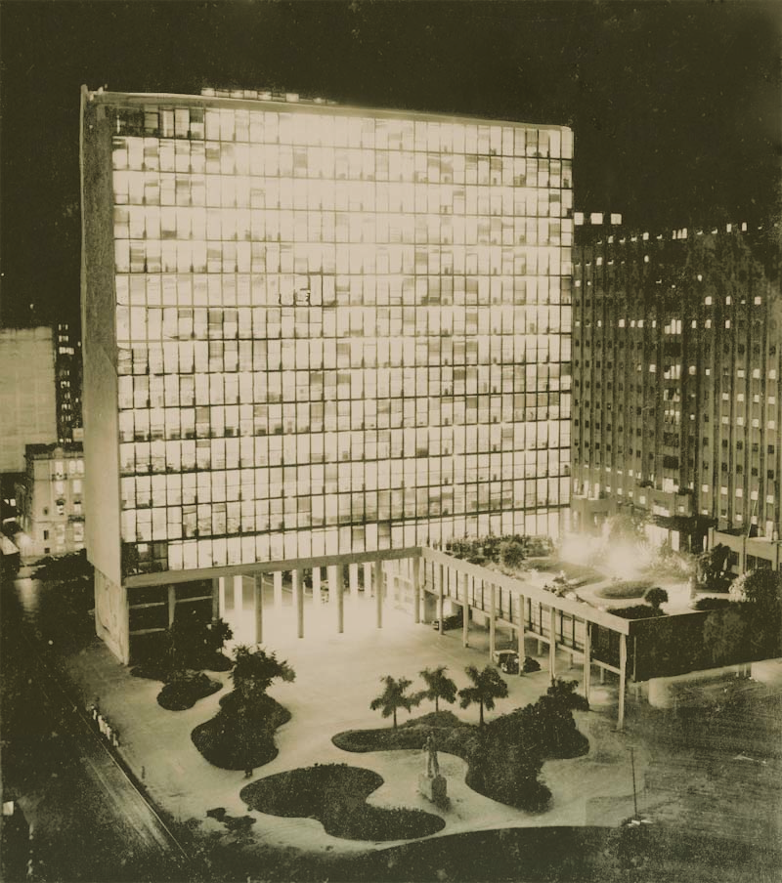
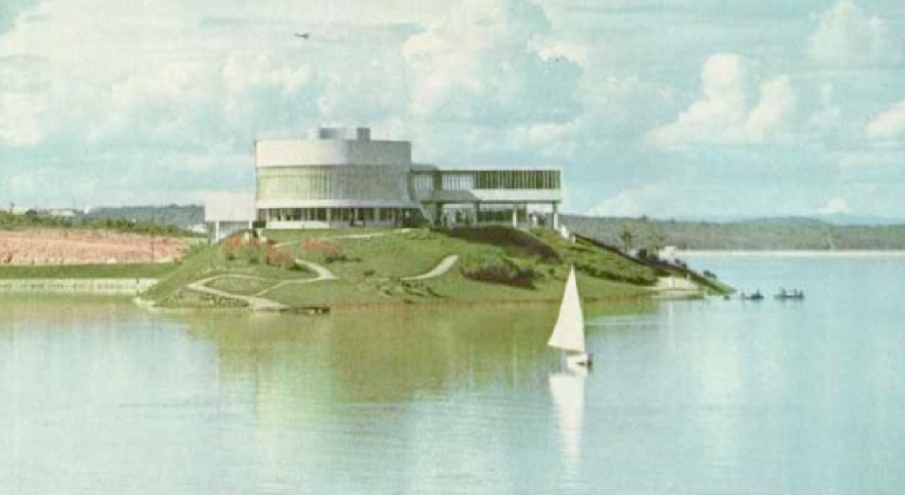
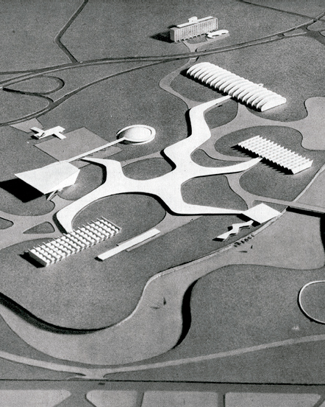
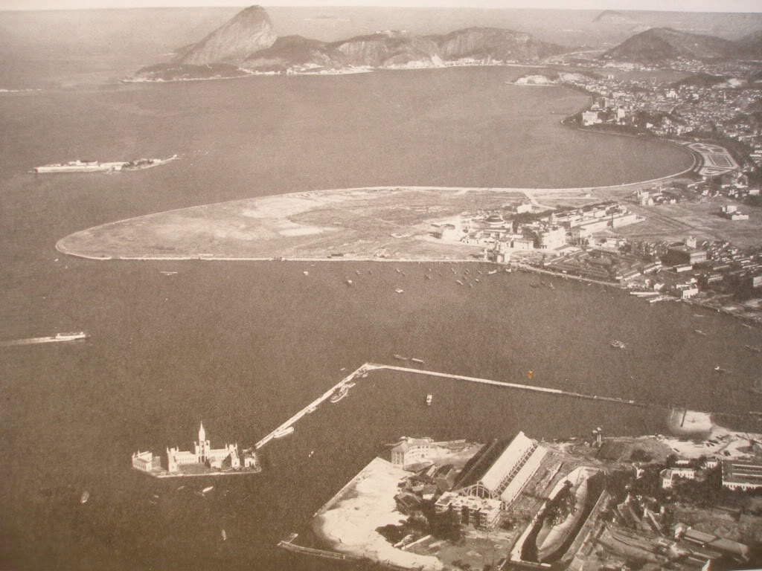
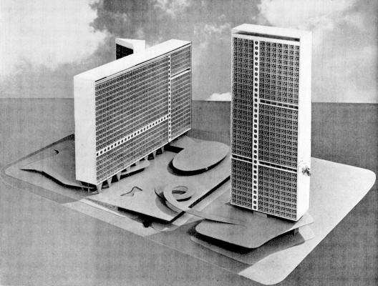
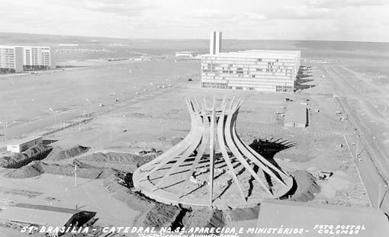
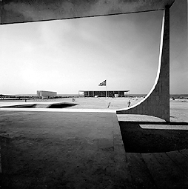
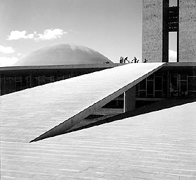
Brazil is
modernist

Slide 3
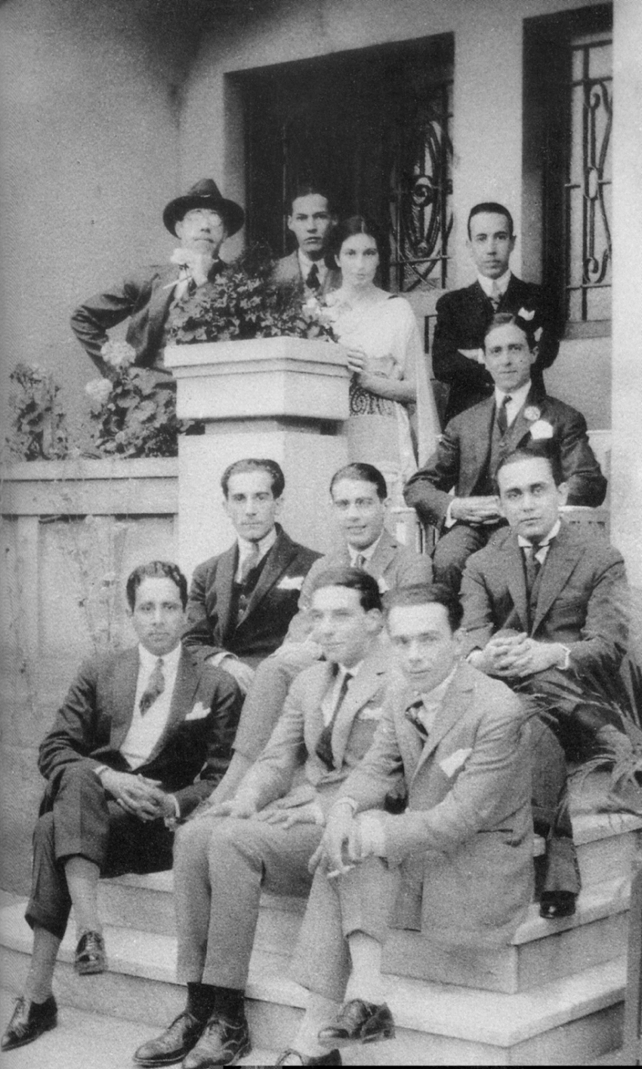
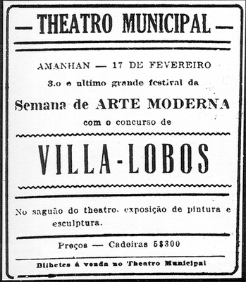
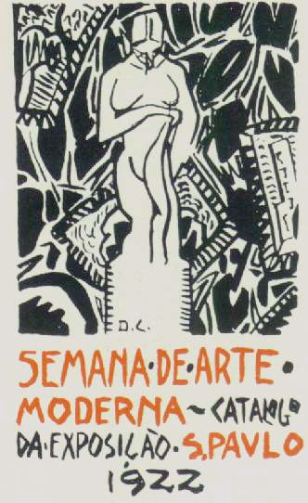
São Paulo
is modernist

Slide 4
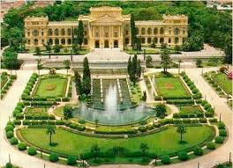
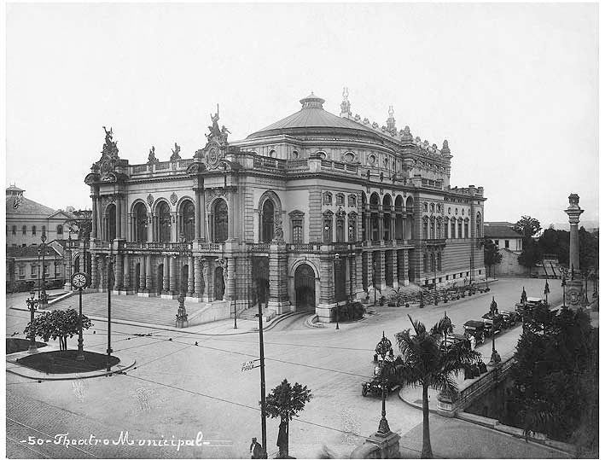
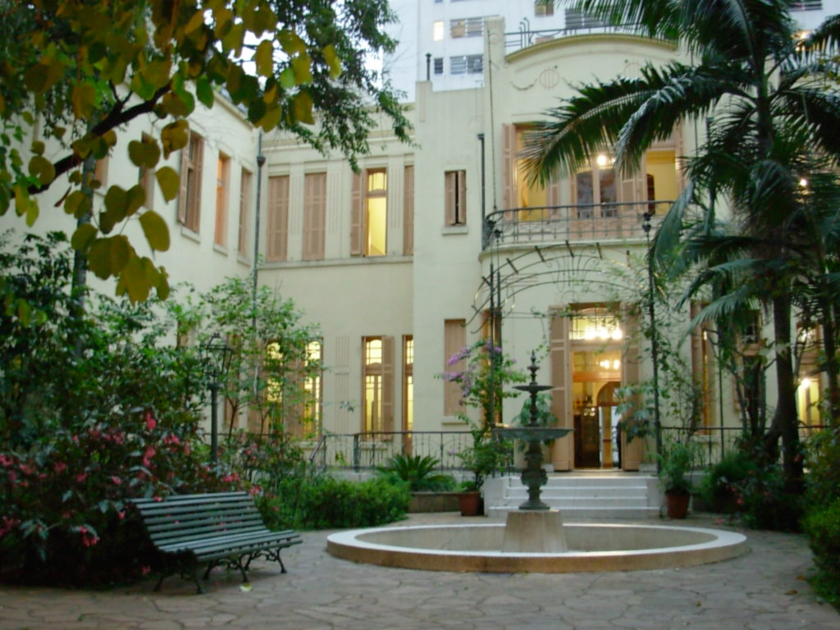
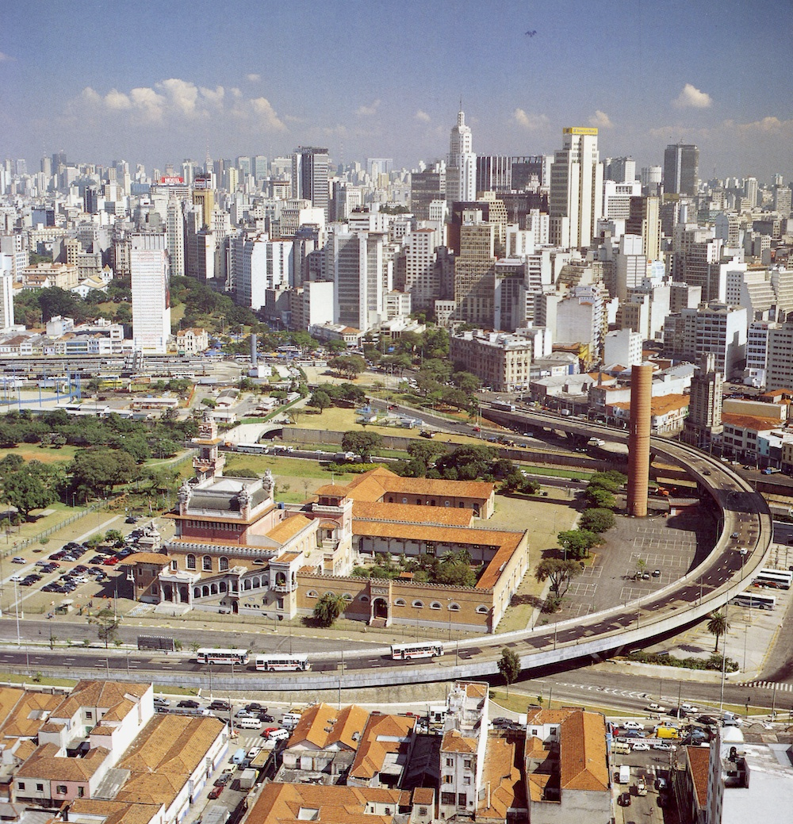
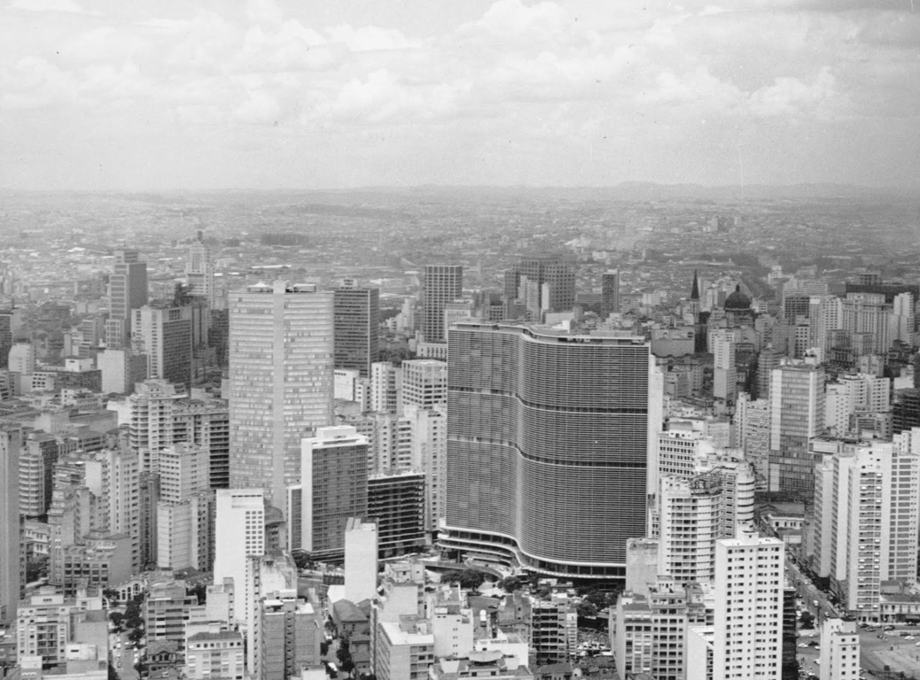
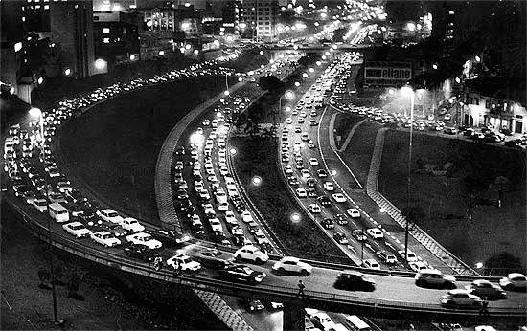
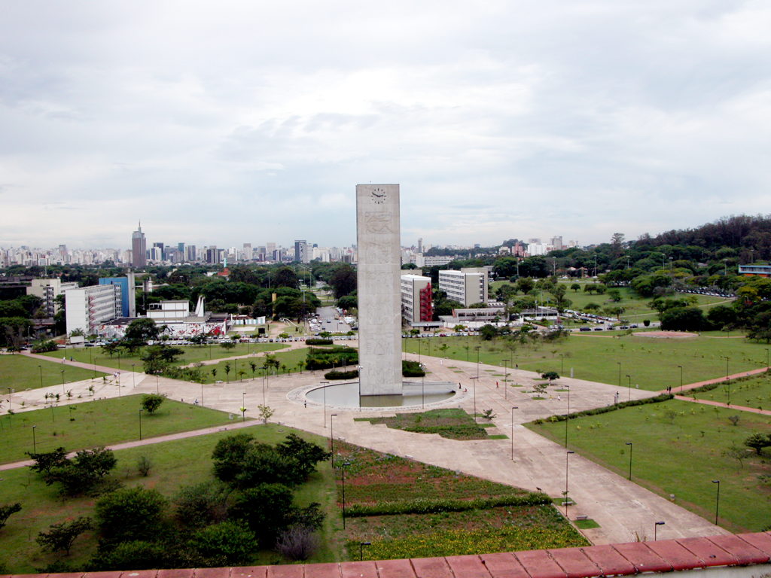
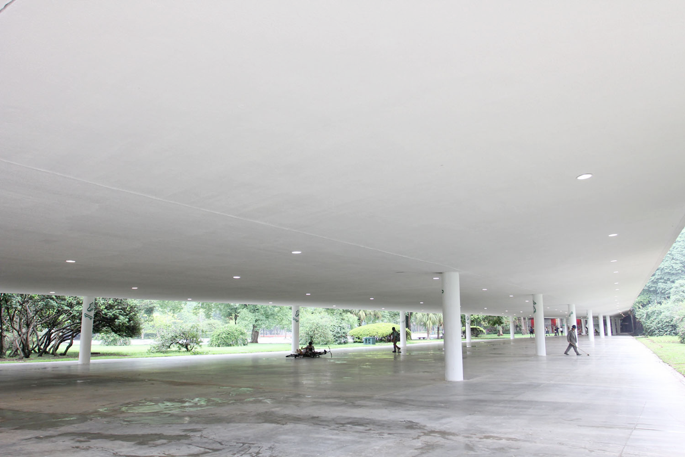
São Paulo and USP
são
are modernist

Slide 5
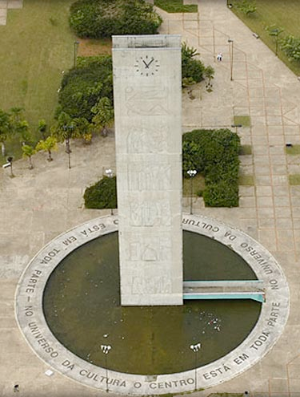
Clock tower (1954-73): architectural design of Rino Levi, with bas-reliefs authored by Elizabeth Nobiling. It is a landmark sculpture in the landscape of the campus, centered in the Clock Square. The water mirror that surrounds the structure contains the following phrase on its border: the center is everywhere in the cultural universe (Miguel Reale [1910 -2006], former president of USP for two terms).

Slide 6
The various cultures of USP
USP - University of São Paulo is:
home to a diversity of cultures: the scientific, that of the carriers, that of the specialties, the generational, those of different "castes", the ideological, that of the unions, and of course that of the aesthetic reference, which houses the activities commonly recognized as cultural.
a confederation of cultures, skills, knowledge, and of course, power.

Slide 7
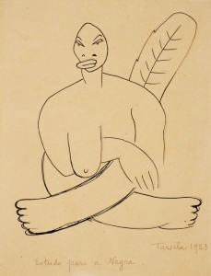
USP has established itself as an international university in the world stage, in a geopolitics dominated by a global influence model that existed from post-WWII to the fall of the Berlin Wall: a "North" consisted of a partnership between the New American World and the Old European Continent. However, in this "imperialist" situation we have been able to model not only our own landscape, as well as structures, forms, content (knowledge)... all modernist. We did it the antropofágico (cannibalistic) way. This is easier and commonly related to art and architecture, but it is also true in the regionalization (nationalization) process of Science. Some of the main uspiano modernist agents can be seen here:

Slide 8
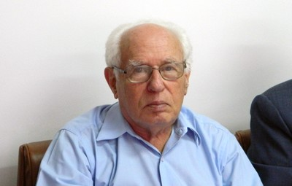
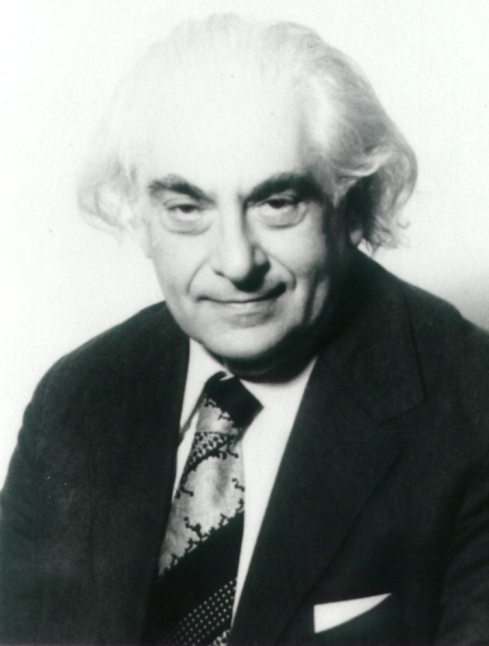
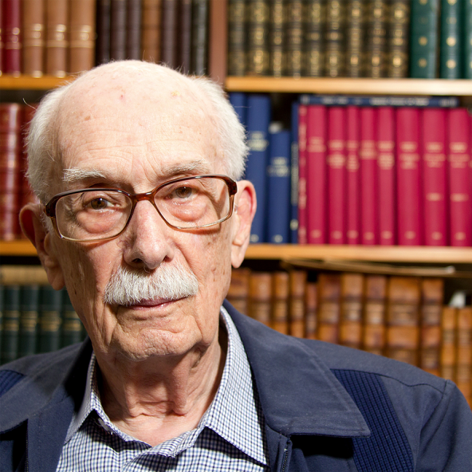
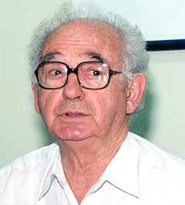
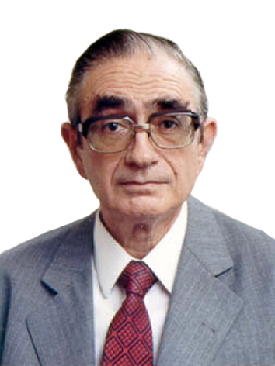
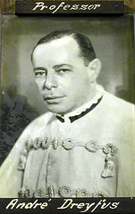
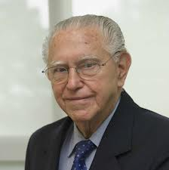
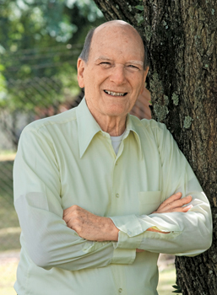
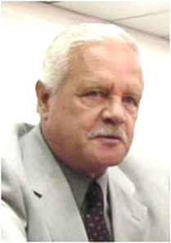
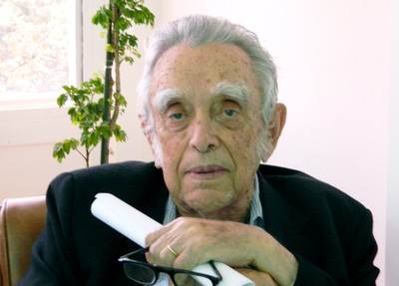
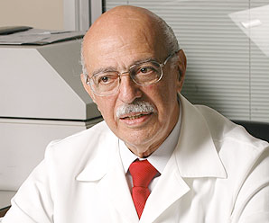
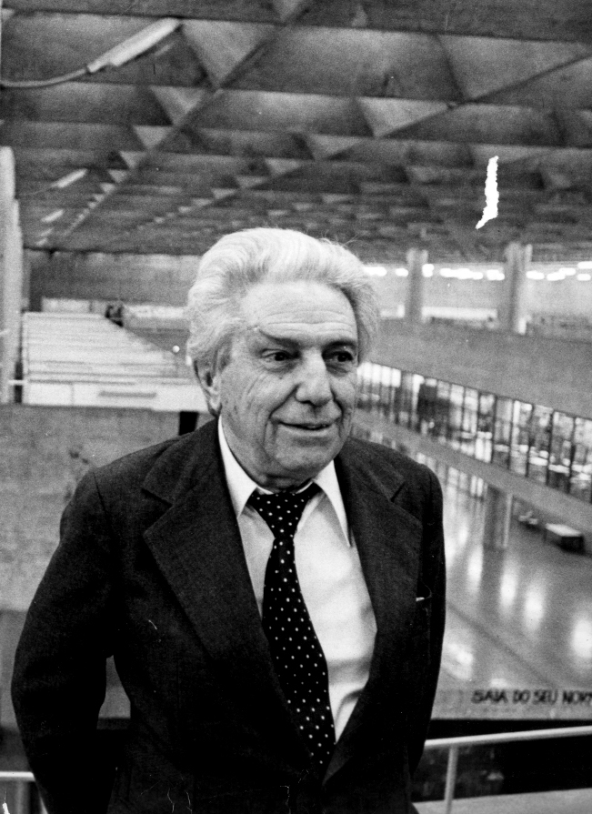
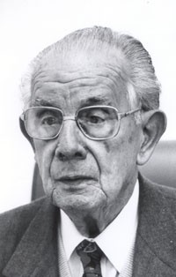
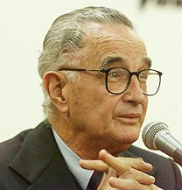
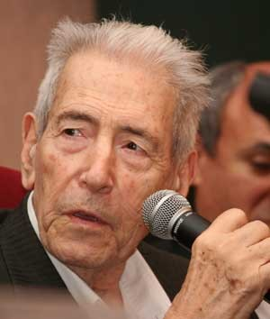
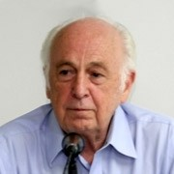
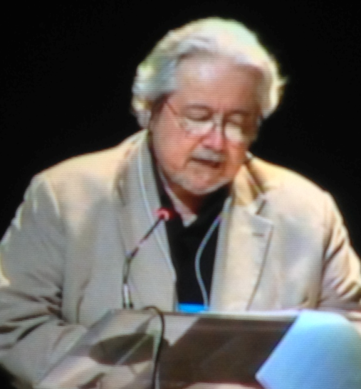
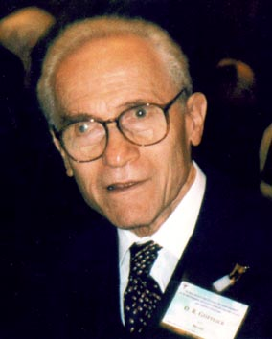
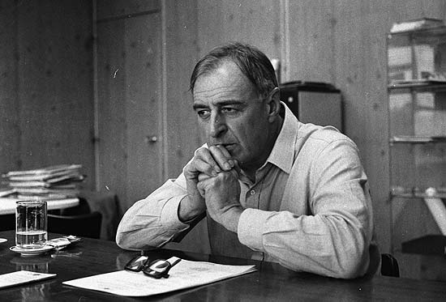
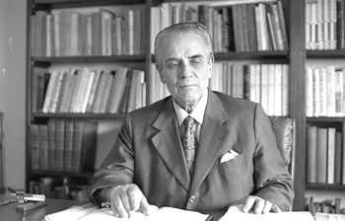
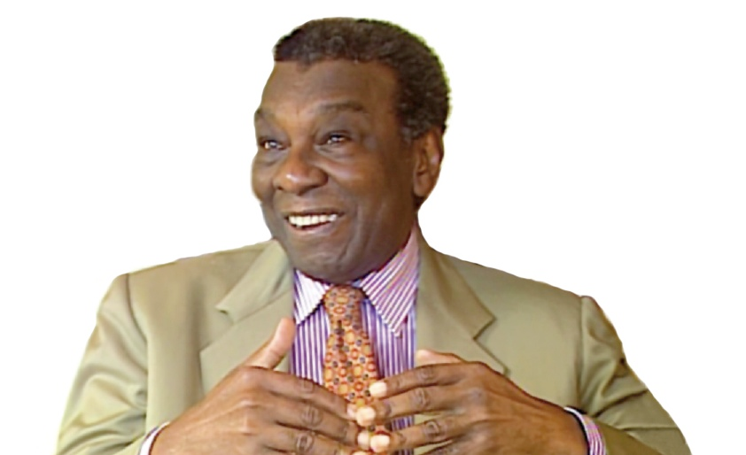
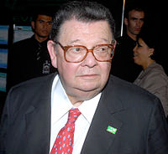

Slide 9
Antonio Carlos Bresser-Pereira – Political Sciences
Villanueva Artigas - Architecture
Aziz Nacib Ab’ Sáber – Geography
Alberto Carvalho da Silva – Medicine
Otto Gotlieb - Chemistry
Walter Zanini - Art History
Antonio Delfim Neto – Economics
Gofredo da Silva Telles Junior – Law
Milton Santos - Geography
From the top, starting from the left:
José Goldemberg - Physics
Mario Schenberg – Physics and Mathematics
Antonio Cândido de Mello e Souza - Sociology
Octavio Ianni - Sociology
Florestan Fernandes - Sociology
Gerhard Malnic - Medicine
Erney Plessmann de Camargo - Medicine
Andre Dreyfus - Biology
Paulo Nogueira-Neto – Natural History
Moacyr Krieger - Medicine
Adib Jatene - Medicine
Crodowaldo Pavan - Biology
Ulpiano Bezerra de Meneses - Archeology

Slide 10
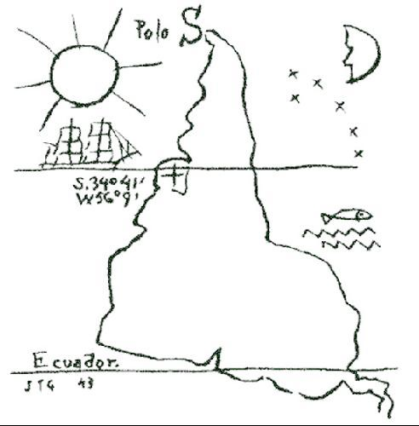
These gentlemen, professors, researchers, intellectuals, among many others, have been responsible for the implementation of the knowledge from "North" to "South". At the highest modernist spirit, they have viewed the possibility of this transposition and, in an enlightened and visionary way, have set this vision of a new world in motion, thus actively participating in the configuration of another modernism matrix in a geopolitical context of international order. They have nationalized, modernized, regionalized, "customized", or rather contextualized knowledge, art, culture, well... everything necessary in the formation of a new structure: a new and original "motherboard".
"Our north is the south!“ (Torres Garcia, 1943)

Slide 11
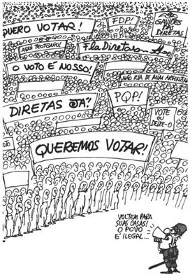
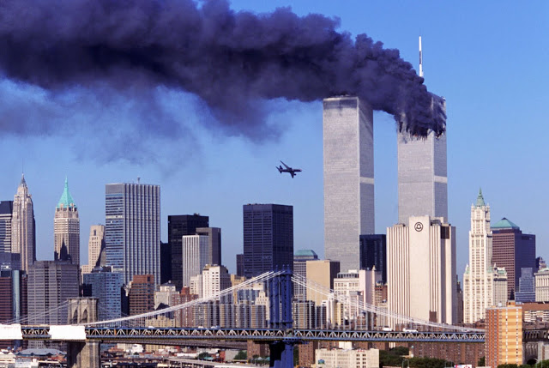
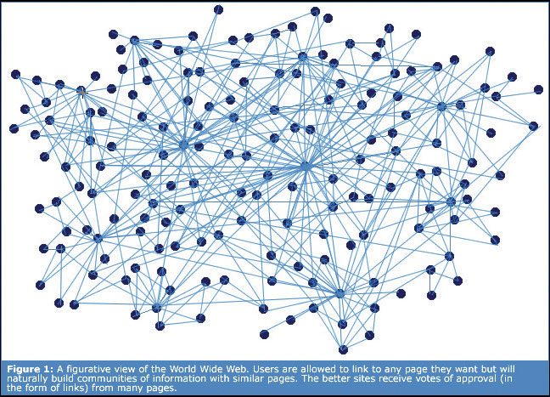
However, a new geopolitical and postcolonial paradigm that began to be drafted in the 60's-70's was only really consolidated from the 80's.
In Brazil, with the end of dictatorship and the restoration of democracy;
In the world, with the fall of the Berlin Wall, gaining complexity with the attacks on September 11 in New York.
The technological matrix also became more sophisticated with the development of virtual dimensions, such as the Internet and the World Wide Web.
The world since then is obviously another one. The modern began to be called postmodern, the situation is no longer international (term that assumes dominant centrality: "the North") and terms like "globalization" started being used.

Slide 12
"One is not born, but rather becomes, a woman." Simone de Beauvoir (1949)
“Women who seek to be equal with men lack ambition” Timothy Leary (2005)
The Earth is blue!" Yuri Gargari (1961)
transformations, mutations, reversibilities,
the city has become the world: anthropocene
the game of life is mainly in our hands
ecology, sustainability, environment and society...
from the concept of people to that of crowd and to commons, the community, the public sphere
accessibility, creative commons
more than Globalization: GLOCALITIES
post-post-colonialism: heightened regional awareness, geo-political criticism, relativism, otherness, integration, interactivity, minorities, etc.

Slide 13
“In the third dimension we have one classroom, while in the fourth we have eight of them. All these potentially relate in the same space-time. This is repeated in relation to museums and libraries. We have left a cuboid architecture for a hiper-cuboid one. If science has studied the existence of parallel universes, why not think and plan a university that allows the existence of parallel (virtual) classrooms, laboratories, museums and libraries, interconnected to their material versions?”
(GROSSMANN, Martin, The University in Virtuality”, USP’s Journal #35, 1997)
The University in Virtuality

Slide 14
The University could be imagined and modeled in virtuality as a combination of environments, such as an n-dimensional ensemble. This was critically developed in the implementation of the project USPonline (1995-98) as opposed to the dispersion found at USP, in particular at the Butantã campus, where there is no clear centrality, no civic center, nor originally a pilot or a master plan. In truth, the faculties, specialized institutes, museums and other organizations that make up this modernist landscape have been arranged in this area without the guidance of a base urban and academic project, a characteristic that is repeated in the other 12 campuses USP around the state.
Would that sentence be a justification for the lack of centrality on this campus?

Slide 15
That is, USP, in this modernist composition of a campus, has never had a clear idea of mobility, integration and organization of the elements that make up this rich territory that generates and maintains information, knowledge, culture, innovation and art.
If there is no centrality, a central core of this territory and its community, there is no social / scientific / academic / cultural interface that represents / institutionally symbolizes the University. Its confederative structure, decentralized, clearly reflects on this field of amorphous structure. Unlike other modernists college campuses, this one almost rejects this - not only symbolic but corporate, social and logistical - need to offer, from its conception, a design in which its buildings and streets relate towards the University’s purposes and activities.

Slide 16
INVESTING IN THE POETIC STRUCTURE OF THE UNIVERSITY:
IN INVENTION!
UBIAS TO FOSTER THE UNIVERSITY AS PLACE, FIELD, ENVIRONMENT, INTERFACE, TERRITORY, LABORATORY, EXPERIMENT, DEVICE, PLATFORM, DIRECTED TO THE TRANSFORMATION, EXPANSION, DEVELOPMENT AND IMPROVEMENT OF SCIENCE, ART AND CULTURE.

